Slide 1
Nathaniel Gray – Kinase Inhibitor -Cellpainting

Slide 2
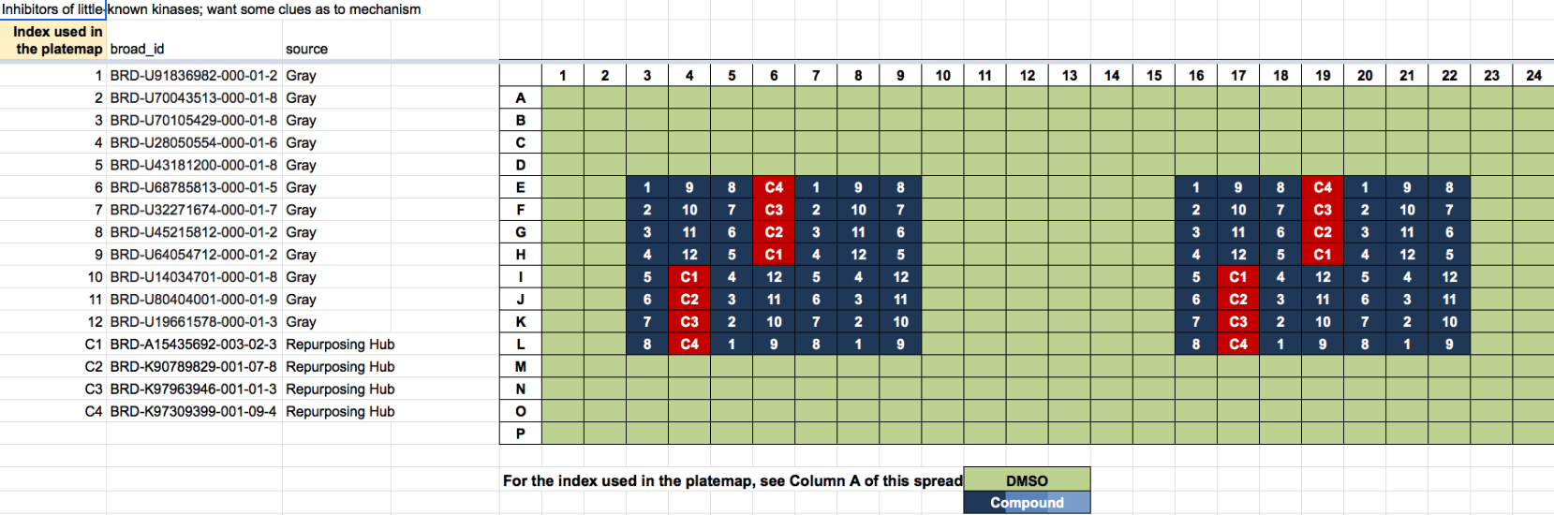
Plates: 2
Cell lines
C-7210-01-CMP-008-gray
U2OS
C-7210-01-CMP-008-gray
A549

Slide 3
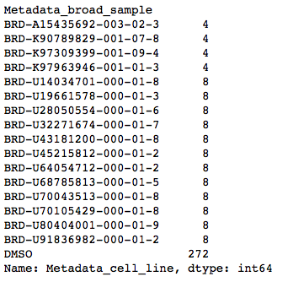
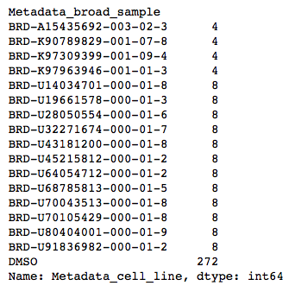
Replicates
C-7210-01-CMP-008-gray_A549
C-7210-01-CMP-008-gray_U2OS
C1
C1
C2
C2
C4
C4
C3
C3

Slide 4
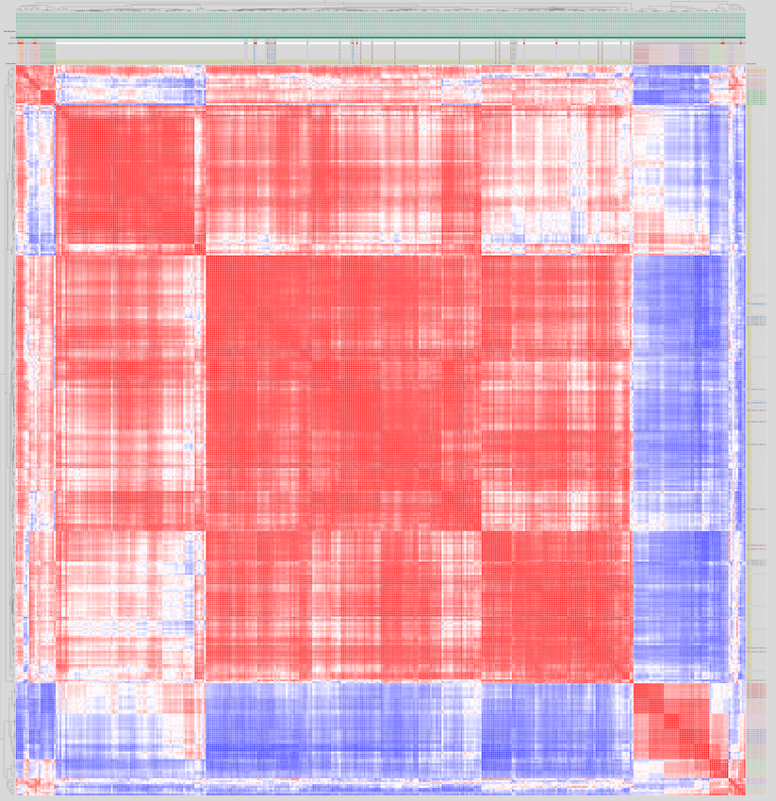
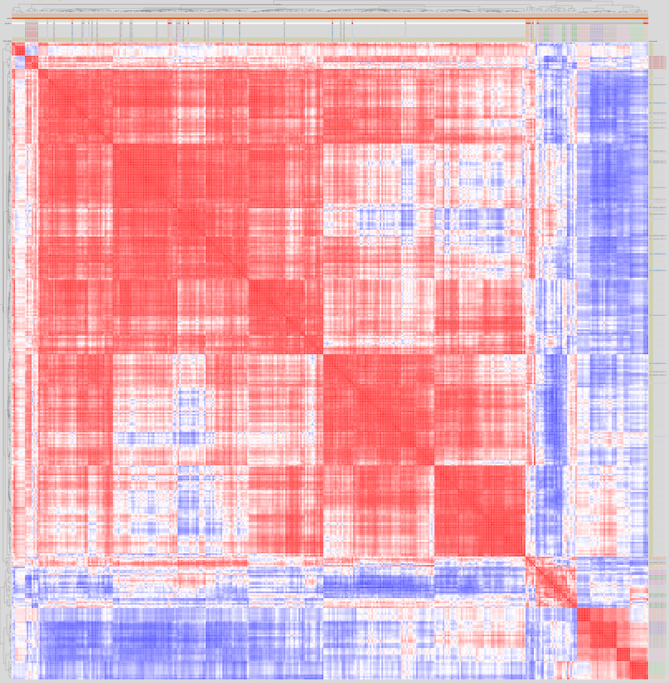
C-7210-01-CMP-008-gray_A549
C-7210-01-CMP-008-gray_U2OS
Compounds with distinct profiles compared to control

Slide 5
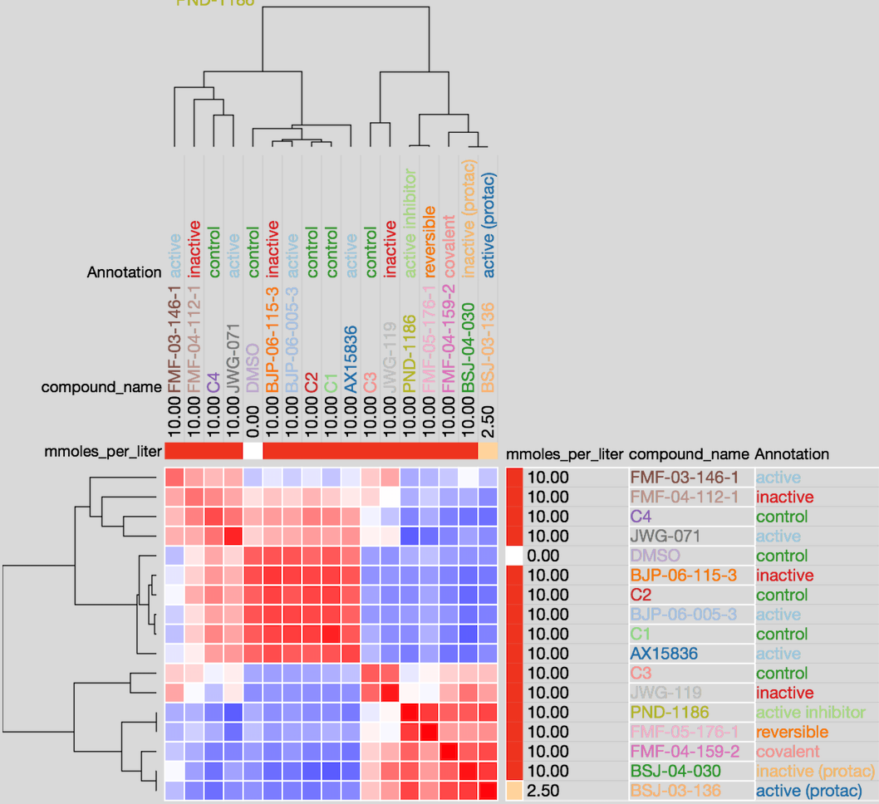
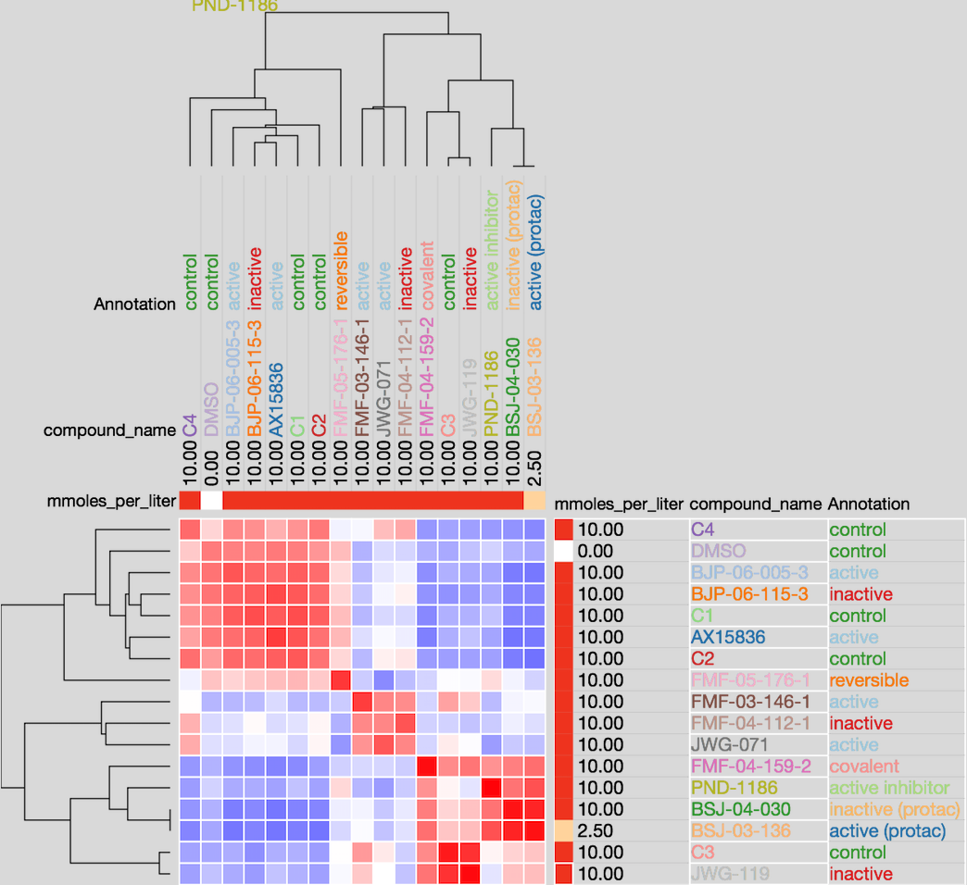
C-7210-01-CMP-008-gray_A549
C-7210-01-CMP-008-gray_U2OS
DCLK1
DCLK1
ERK5
PIN1
PIN1
PIN1
ERK5
PIN1
CDK14 /pan-TAIRE
ERK5
DCLK1
DCLK1
ERK5
ERK5
FAK
CDK14 /pan-TAIRE
CDK14 /pan-TAIRE
FAK
CDK14 /pan-TAIRE
SECRET
SECRET
SECRET
SECRET
ERK5

Slide 6
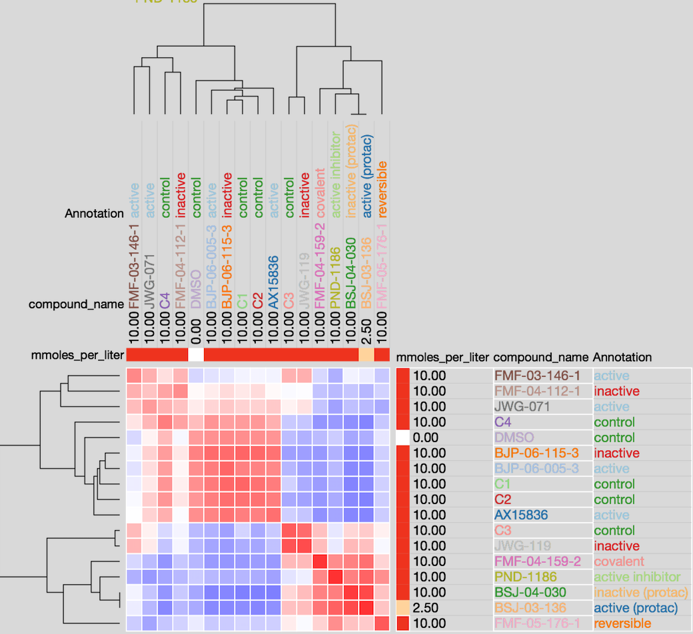
C-7210-01-CMP-008-gray (Merged data)
DCLK1
DCLK1
ERK5
PIN1
PIN1
ERK5
ERK5
CDK14 /pan-TAIRE
FAK
SECRET
SECRET
CDK14 /pan-TAIRE
Note: Compound(active state) targeting ERK5 displayed similar profiles, and disilimar
with inactive compound

Slide 7
Linkage Analysis
(Method: ’Ward’)
C-7210-01-CMP-008-gray_A549
C-7210-01-CMP-008-gray_U2OS

Slide 8
C-7210-01-CMP-008-gray

Slide 9
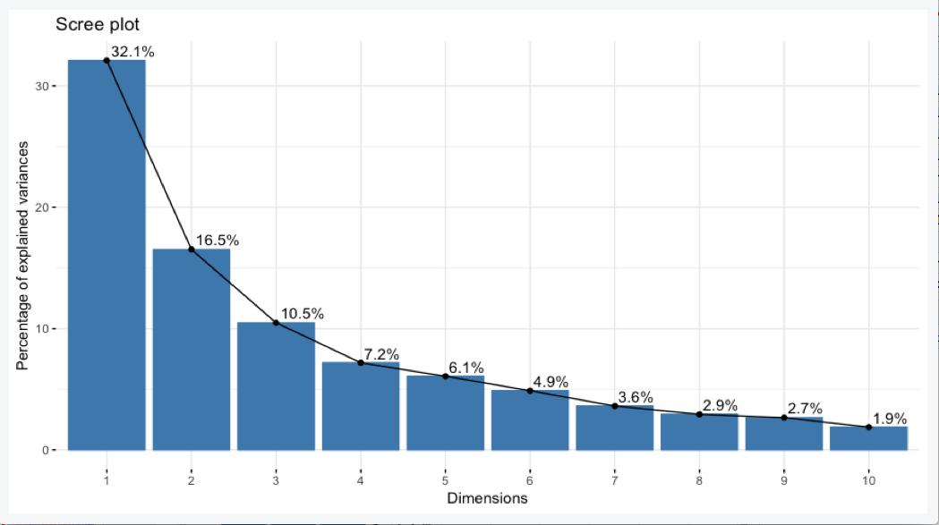
ScreePlot
Note: First two PC components explained 49% of variations

Slide 10
FAK
Note:Some compounds displayed distinct clustering in PC space

Slide 11
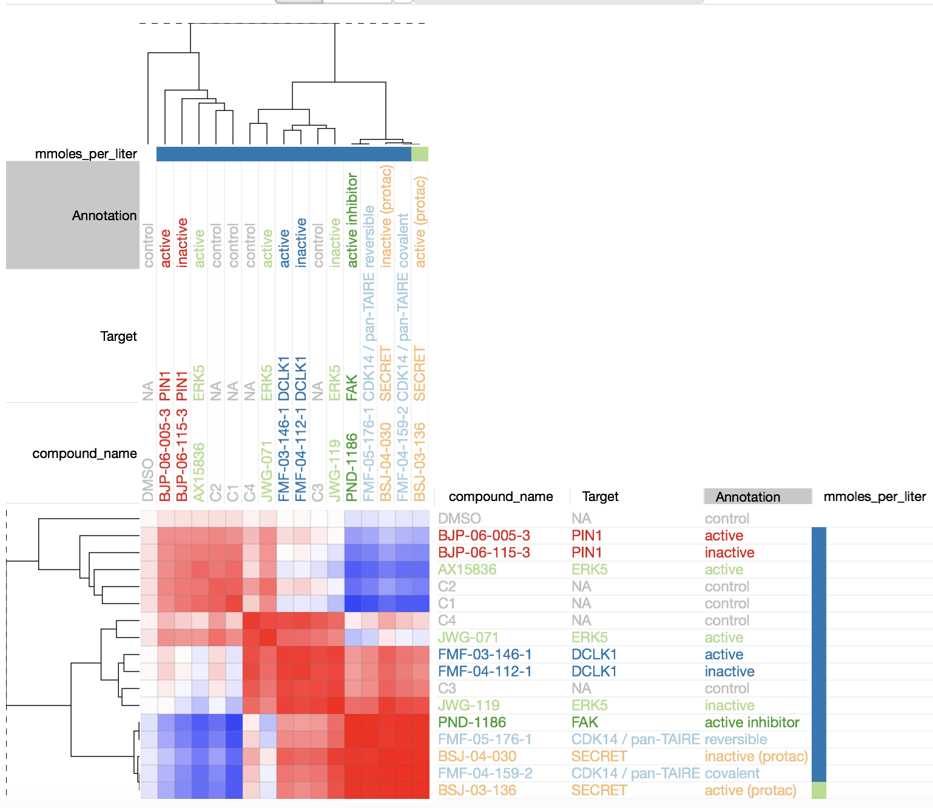
New Strategy: Variables normalization by subsampling of controls (DMSO-112)
Old
New
C-7210-01-CMP-008-gray_A549
C-7210-01-CMP-008-gray_A549
DCLK1
DCLK1
DCLK1
DCLK1
ERK5
ERK5
PIN1
PIN1
PIN1
PIN1
ERK5
ERK5
ERK5
ERK5
FAK
FAK

Slide 12
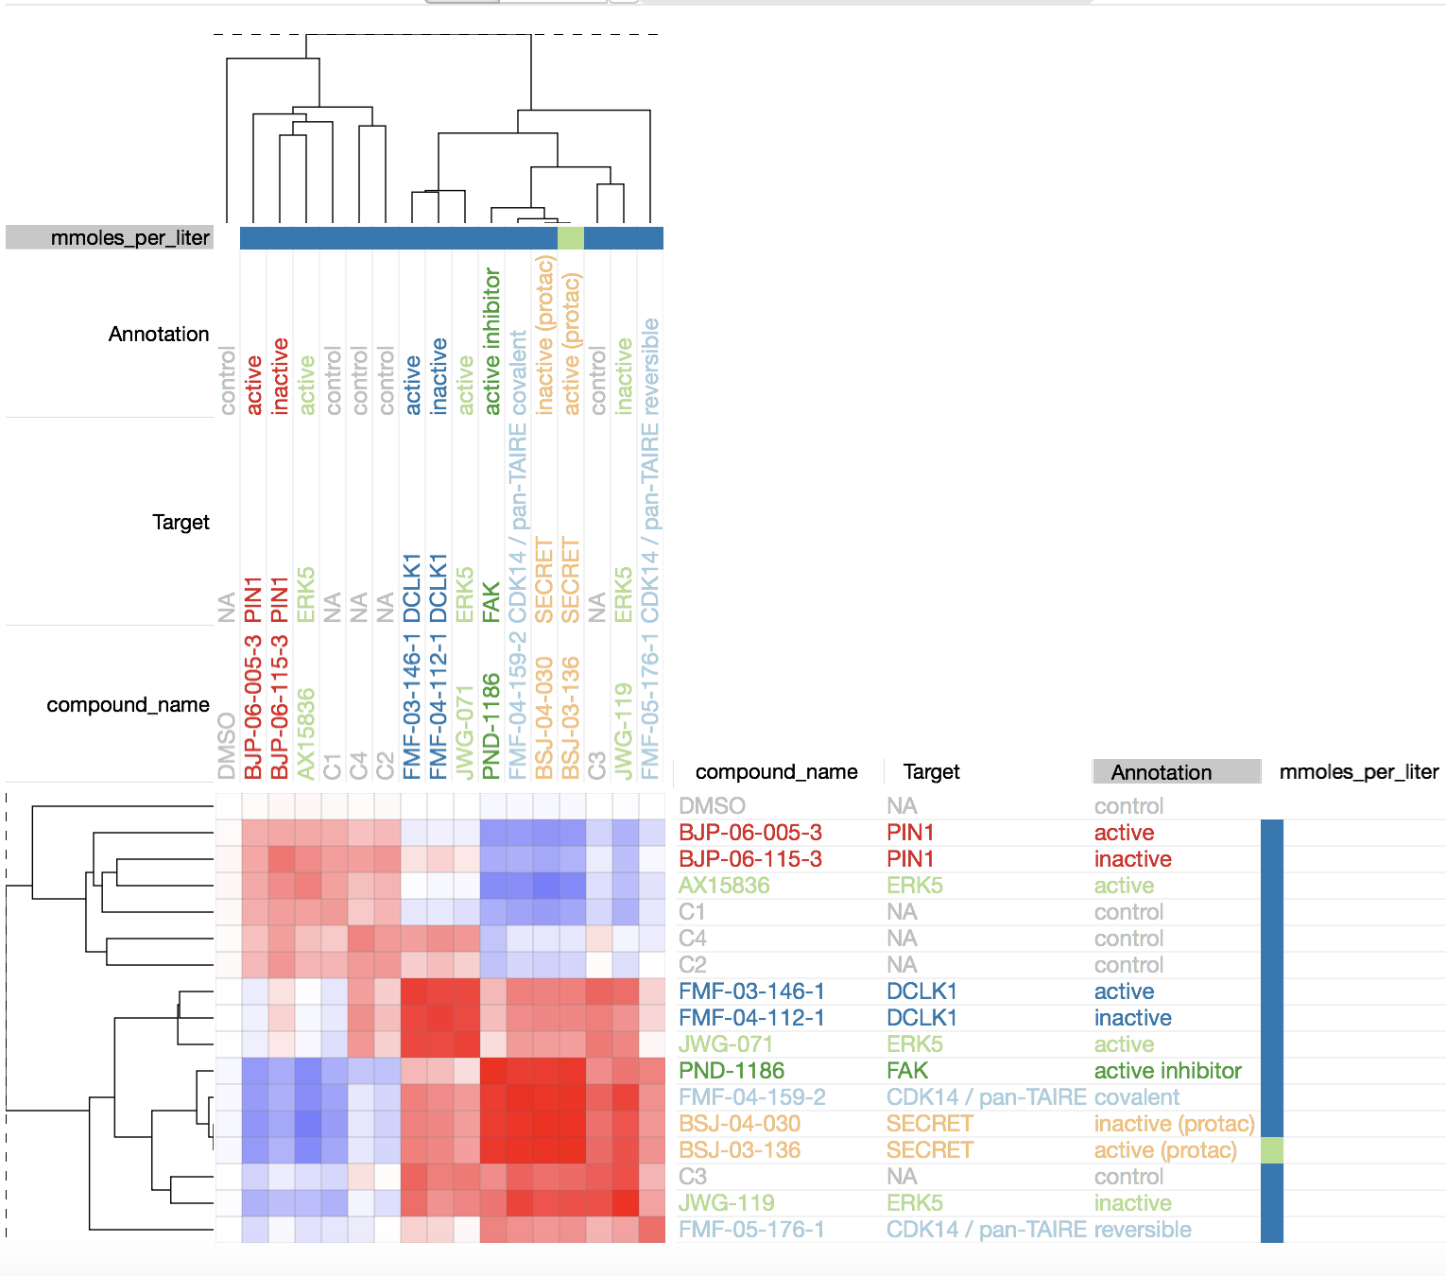
New Strategy: Variable normalization by subsampling of controls (DMSO-112)
C-7210-01-CMP-008-gray_U2OS
C-7210-01-CMP-008-gray_U2OS
Old
New
PIN1
PIN1
ERK5
CDK14 /pan-TAIRE
DCLK1
DCLK1
ERK5
CDK14 /pan-TAIRE
FAK
SECRET
SECRET
ERK5

Slide 13
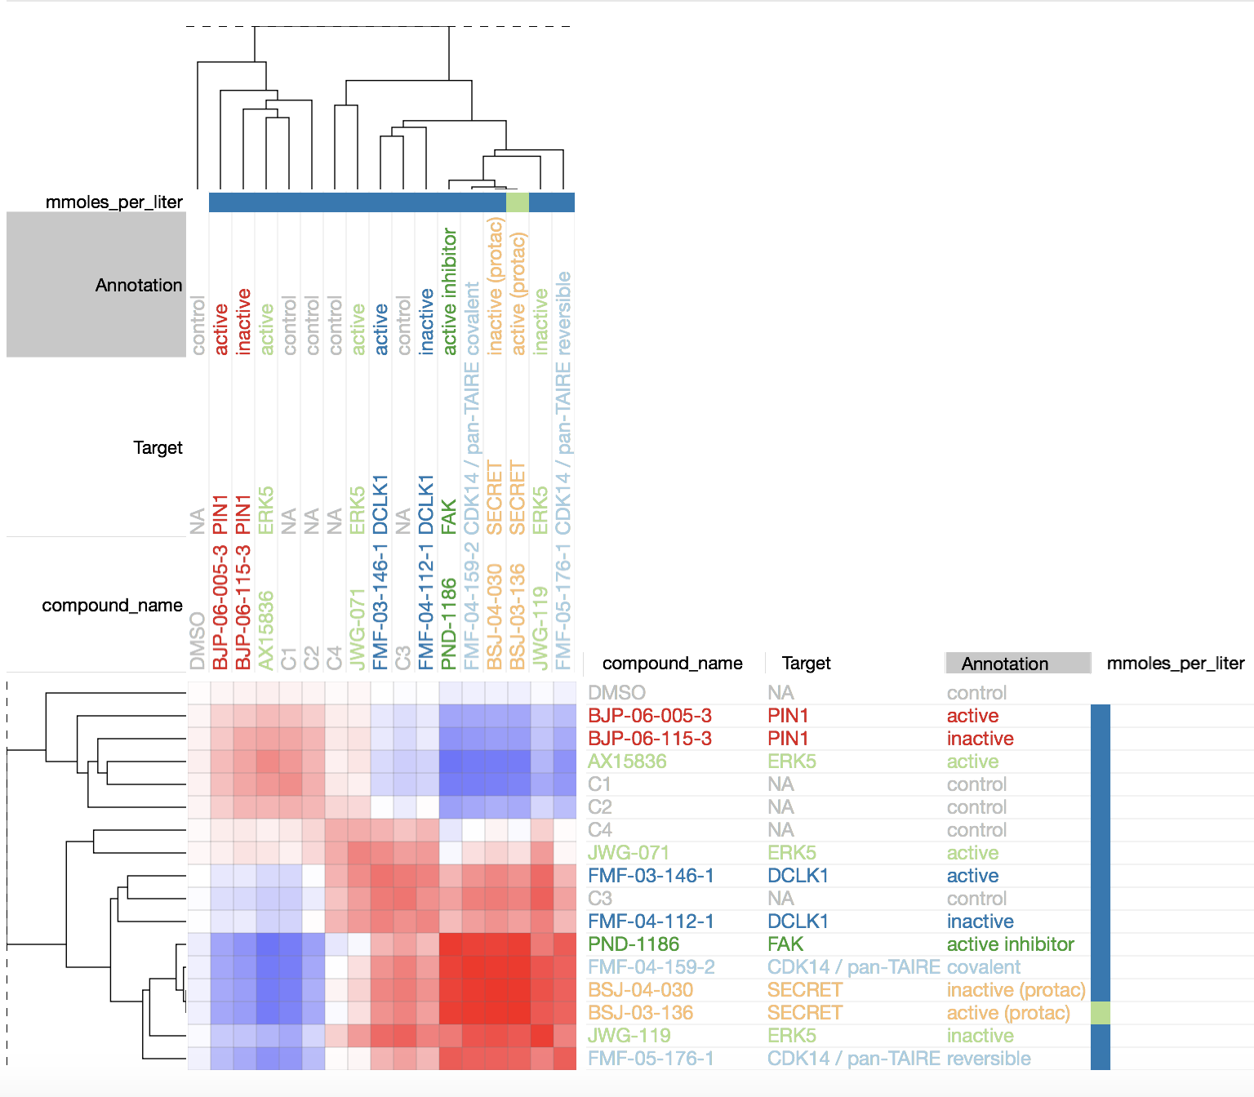
New Strategy: Variable normalization by subsampling of controls (DMSO-112)
C-7210-01-CMP-008-gray (Merged data)
C-7210-01-CMP-008-gray (Merged data)
Old
New
DCLK1
DCLK1
ERK5
PIN1
PIN1
ERK5
ERK5
CDK14 /pan-TAIRE
FAK
SECRET
SECRET
CDK14 /pan-TAIRE

Slide 14
Principal Component analysis
Active, ERK5
Active, PIN1
Inactive, PIN1
Active, Secret
Inactive, Secret
DMSO
Active, DCLKI
Inactive, DCLKI
Covalent, CDK14
Reversible, CDK14
Active, ERK5
Inactive, ERK5
Active, FAK

Slide 15
Active, ERK5
Active, PIN1
Inactive, PIN1
DMSO
Active, Secret
Inactive, Secret
ERK5 (Active)
DCLKI
Active, DCLKI
Inactive, DCLKI
ERK5
Covalent, CDK14
Reversible, CDK14
Secret
Active, ERK5
CDK14
Inactive, ERK5
Active, FAK

